Slide 1


WELCOME TO:FENOMENAL STORE by: Vaishnavi Parvatikar

Slide 2
Introduction:
The purpose of this project is that the products can be sold online.
E-commerce is buying and selling of goods and services over an electronic network, primarily the internet.

Slide 3
Abstract:
E-Commerce if the process of doing business through computer networks.
A person sitting on his/her chair can access all the facilities of the internet to buy and sell the products.
Unlike traditional commerce that is carried out physically with effort of a person to go and get products, ecommerce has made it easier for human to reduce the effort.

Slide 4
Functional requirement:
Minimalism: The users are interested in buying the product that they want, which is why they need a simple interface, intuitive categories and the necessary information.
Mobile First: Seeing as how the majority of traffic online takes place via mobile devices, it’s only natural that you need to consider going mobile-first with your design.
Multilanguage support:Since many overseas markets are rapidly growing, you should provide multi-language support on your website to avoid alienating any international customers.

Slide 5
Non-Functional Requirement:
Security: Secure access of confidential data(customers details).
Availability: 24x7 availability
Component design: Better component design to get better performance at peak time.

Slide 6
Implementation Modules:
Online Shopping Cart
Backend
Frontend
Configuration class
DAO implementation class
Model class
DAO test
Controller class

Slide 7
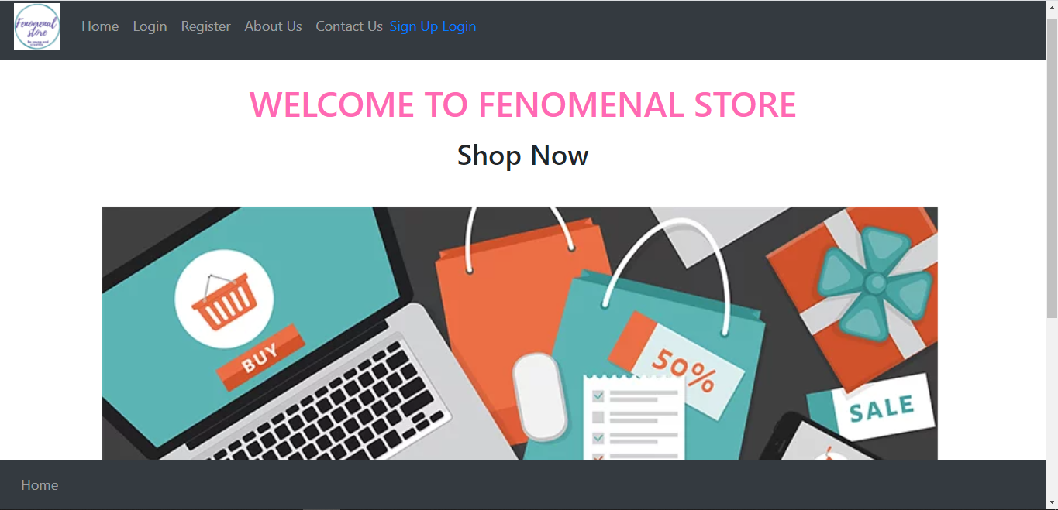
Module Screenshots:

Slide 8
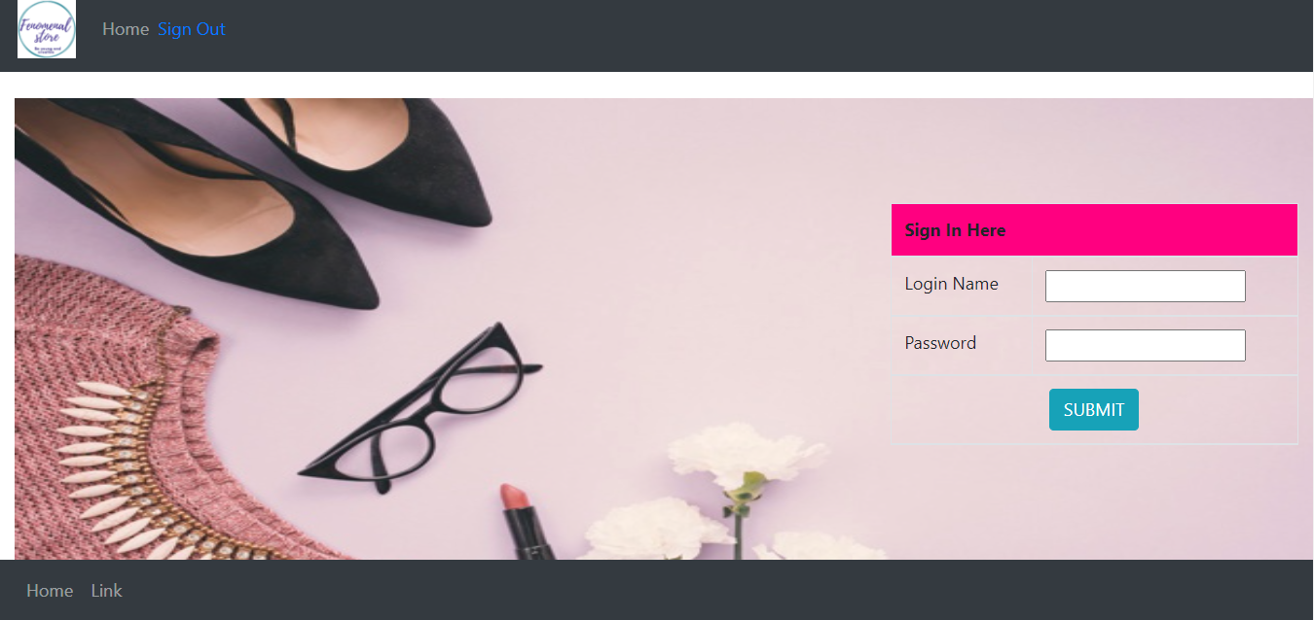
Module Screenshots:

Slide 9
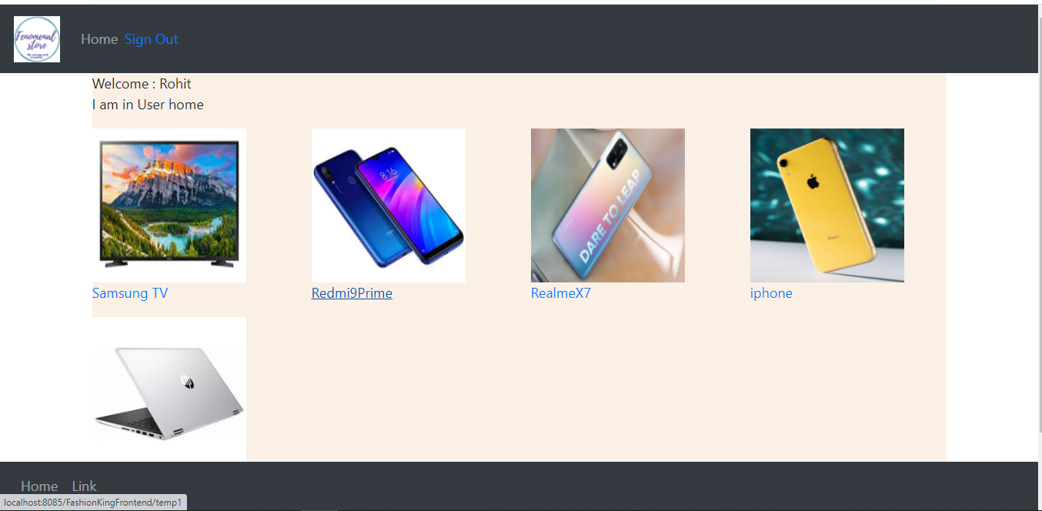
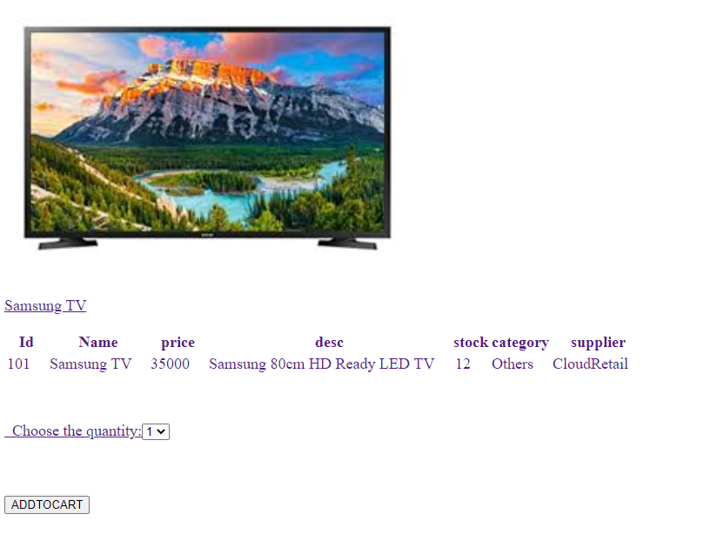
Module Screenshot Cont.….

Slide 10
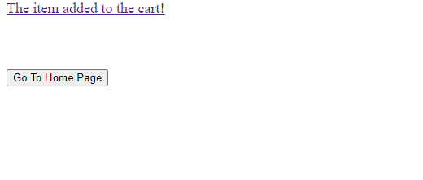
Module Screenshot Cont.….

Slide 11
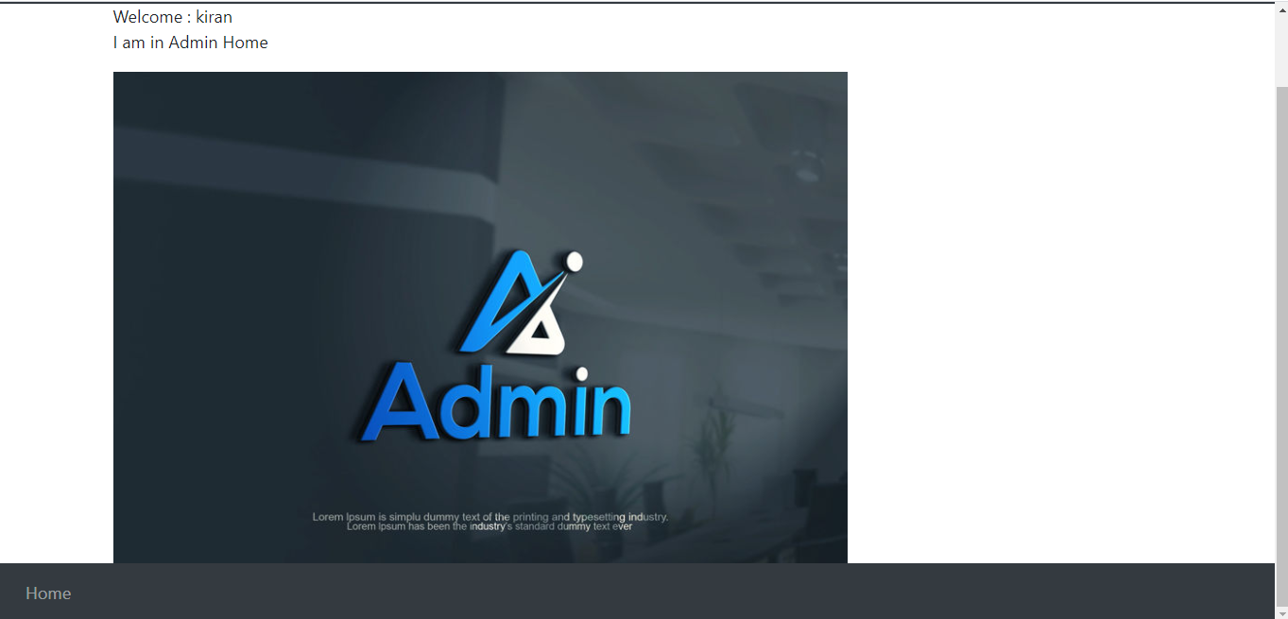
Module Screenshot Cont.….

Slide 12
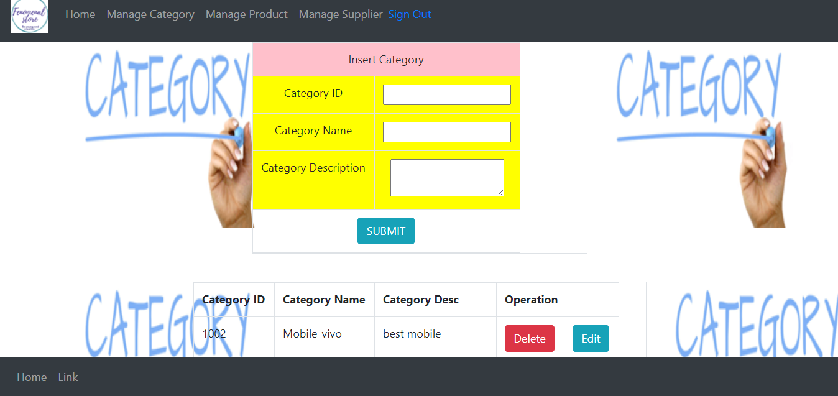
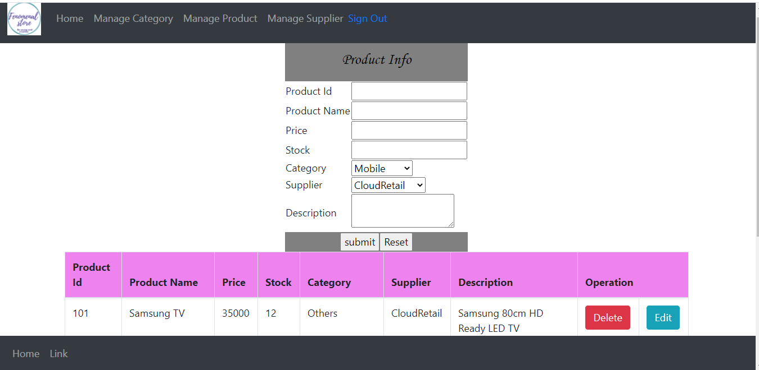
Module Screenshot Cont.….

Slide 13
Database ER Diagram:
image
Product ID
Username
password
ProductName
password
Username
Login
Product Display
User
desc
price
has
Roles
stock
Register
category
address
Admin
Customer name
Product Id
Mobile no
Name
Email Id
Category
Supplier
Product
desc
Category ID
stock
Category Desc
Supplier ID
Name
price
category
Category Name
Desc
supplier

Slide 14
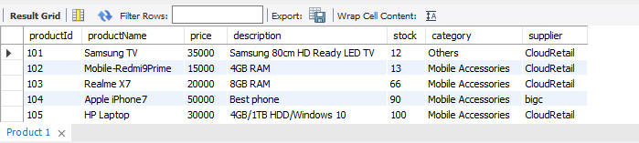
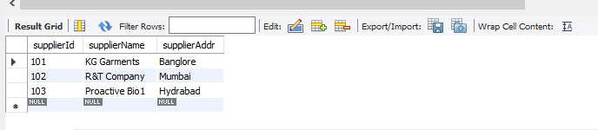
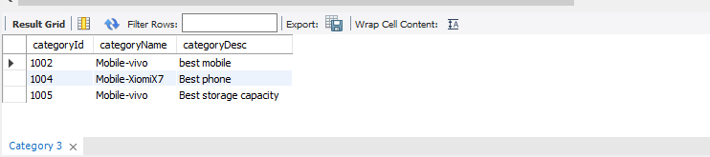
Tables: product table: Supplier table: Category table:

Slide 15
TESTING:
JUnit should be first option when testing the java applications. JUnit can be used separately or integrated with build tools like Maven.
During the process of testing the applications developers may face many problems. The flow of an application cannot be tested only using main() method. For example, for a web application if we want to test the flow we need to deploy it on the server and if there is a change in java code the application should be restarted again therefore testing time is increased.
JUnit can solve all these issues of testing. JUnit is used to test an actual class. Using JUnit we can save testing time.
JUnit has become a standard for testing in Java programming language and it is supported by almost all the IDE’s.
JUnit is one of the best testing frameworks that can be selected for an efficient testing process.

Slide 16
Future Enhancement:
The project can be extended to allow multiple images when user clicks on the product.
Can also include video for that particular product .
The current system is confined only to shopping cart process. It can be extended to have an easy to check out process.
Can improve security level. Making application more secure and reliable.
Project can be upgraded to more advance option such as sort date wise, location wise etc.

Slide 17
Thank You

